Slide 1
Placenta Variations
By Erin Ryan LM CPM

Slide 2
Placenta
a flattened circular organ in the uterus of pregnant eutherian mammals, nourishing and maintaining the fetus through the umbilical cord

Slide 3
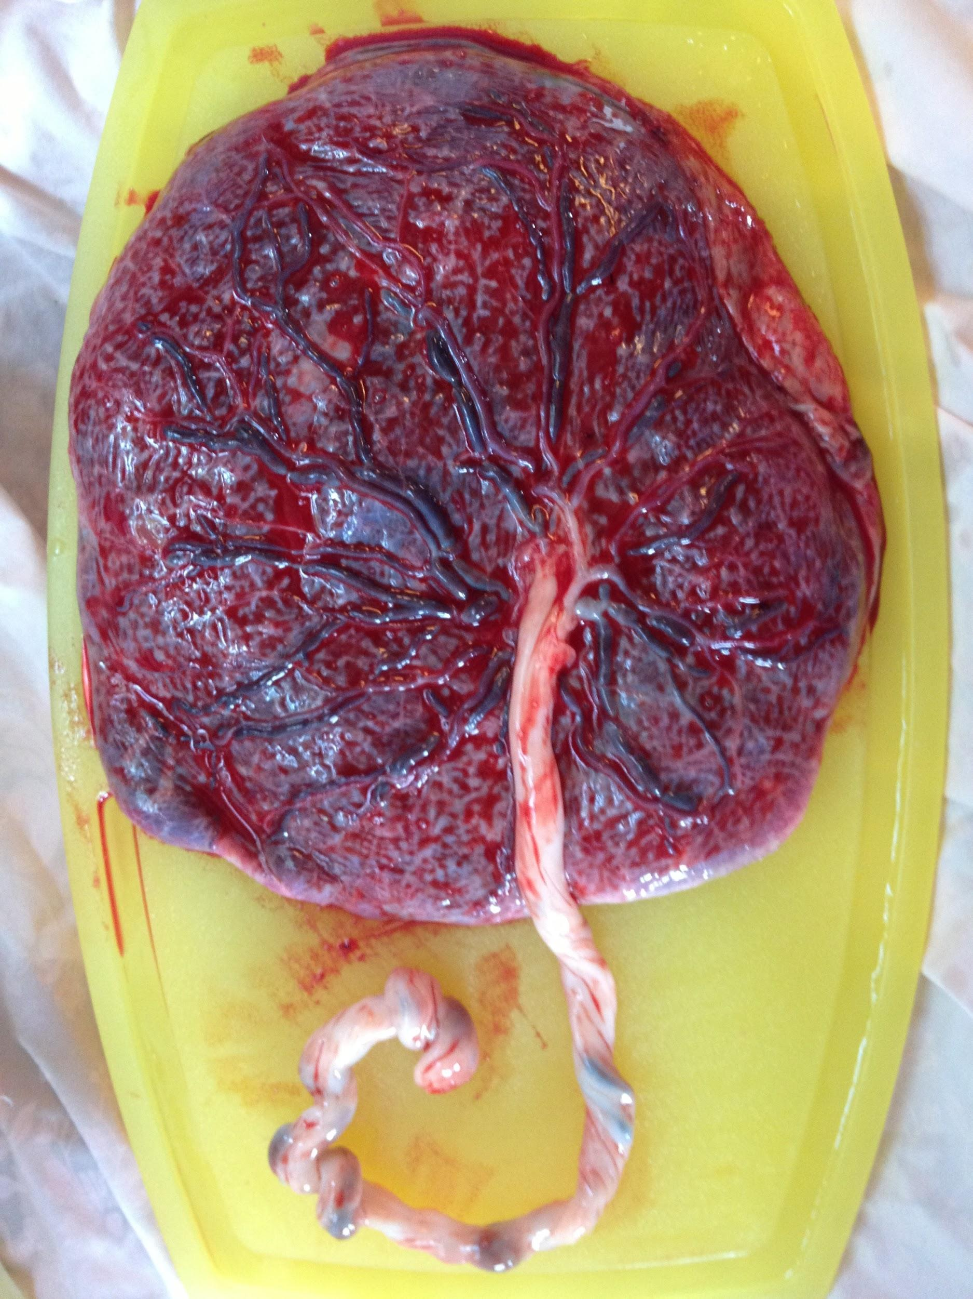
Normal Placenta
Thick
Round
Red
Cord inserted centrally

Slide 4
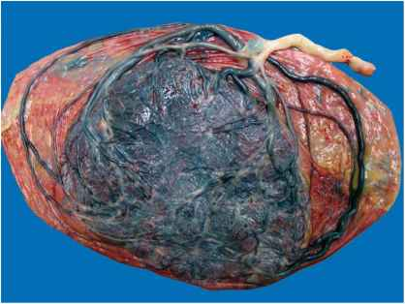
Cord Variations: Velamentous

Slide 5
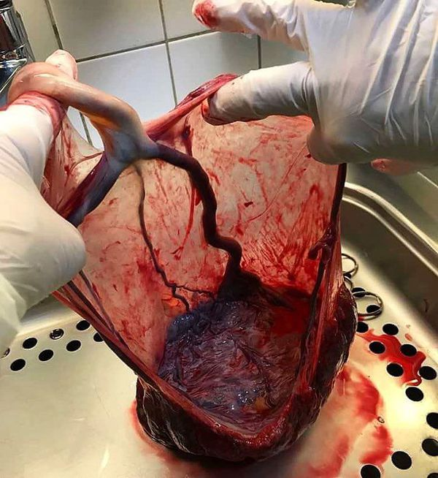
Cord Variations:
Velamentous
Note exposed vessels

Slide 6
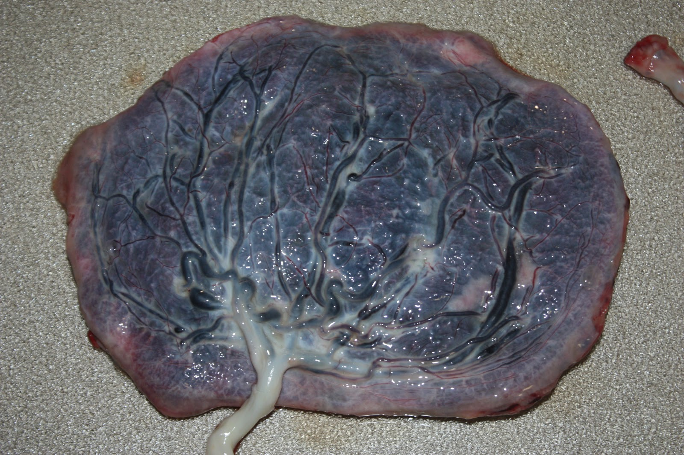
Cord Variation: Marginal

Slide 7
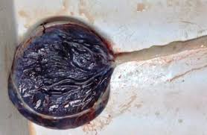
Battledore Insertion and Circumvallate
Battledore is a version of marginal where the cord inserts in the side or edge of the placenta

Slide 8
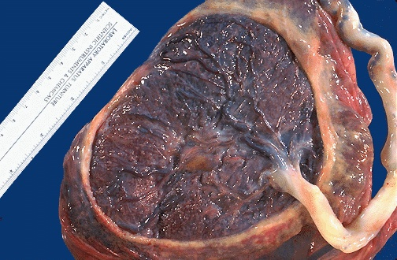
Circumvallate
A peripheral cuplike insertion of the MEMBRANES at the surface of the placenta

Slide 9
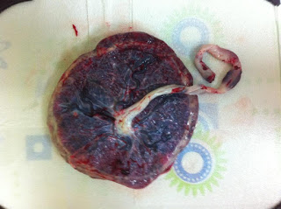
Circummarginate
A flattened edge with a ridge of fibrin making the edge of the vascular place. Can be only a portion of the circumference

Slide 10
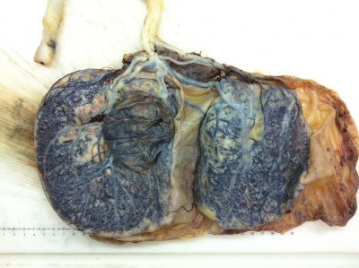
Bilobed (with velamentous insertion)

Slide 11
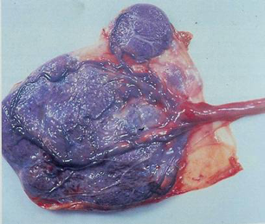
Succenturiate Placenta with Battledore insertion

Slide 12
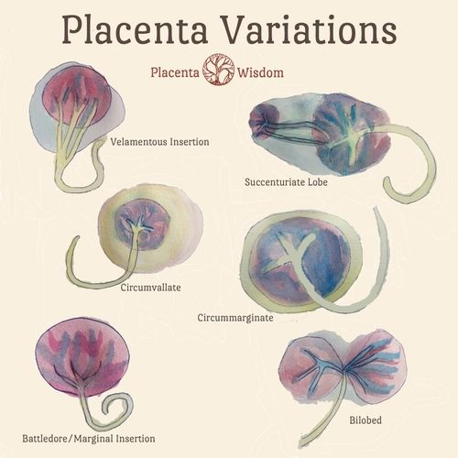
There are many variations and combinations. Have fun expanding your knowledge using google images

Slide 13
Image sources
Empowered Birth Doula Services - WordPress.com
Derick Mussen Healthcare
MEDizzy
Mamabirth.com
Library.med.utah.edu
www.thehumbledoula.wordpress.com
UNSW Embryology
Memorang
Placenta Wisdom

